Slide 1

Steganography vs Cryptography:
Hidden Security in the Digital World
TECHNICAL PRESENTATION
CSA5101 – Cryptography and Network Security
Presented By:
SHAIK ASHA (192473025)
Notes:
Introduce the topic. Two ideas: cryptography hides the meaning of a message, steganography hides the fact that a message exists. Fill in the student details before presenting.

Slide 2


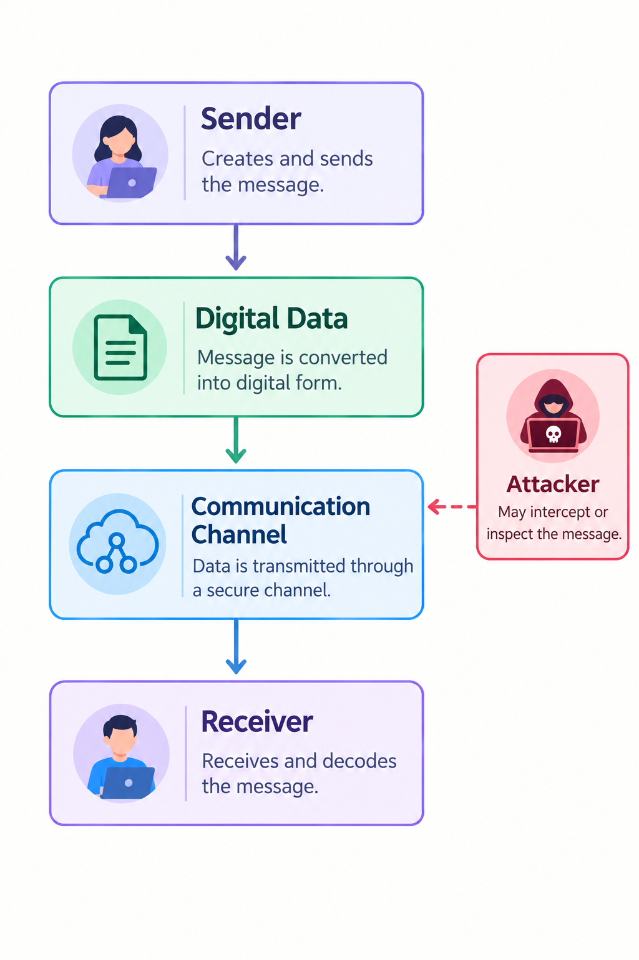
Introduction and Security Problem
Sensitive information is transmitted and stored digitally.
Attackers may intercept or inspect communications.
Encryption protects the content of information.
Steganography hides the existence of the information.
Both techniques address different security requirements.

Slide 3
What is Cryptography?
Cryptography converts plaintext into ciphertext using an algorithm and a key.
Only an authorized user with the appropriate key can recover the original information.
Main processes: encryption and decryption.
Plaintext
Encryption + Key
Ciphertext
Decryption + Key
Plaintext
Simple examples
Caesar Cipher example (shift = 3)
AES – symmetric, one shared key
RSA – public / private key pair
Caesar Cipher – fixed letter shift
Plain
H
E
L
L
O
Cipher
K
H
O
O
R

Slide 4
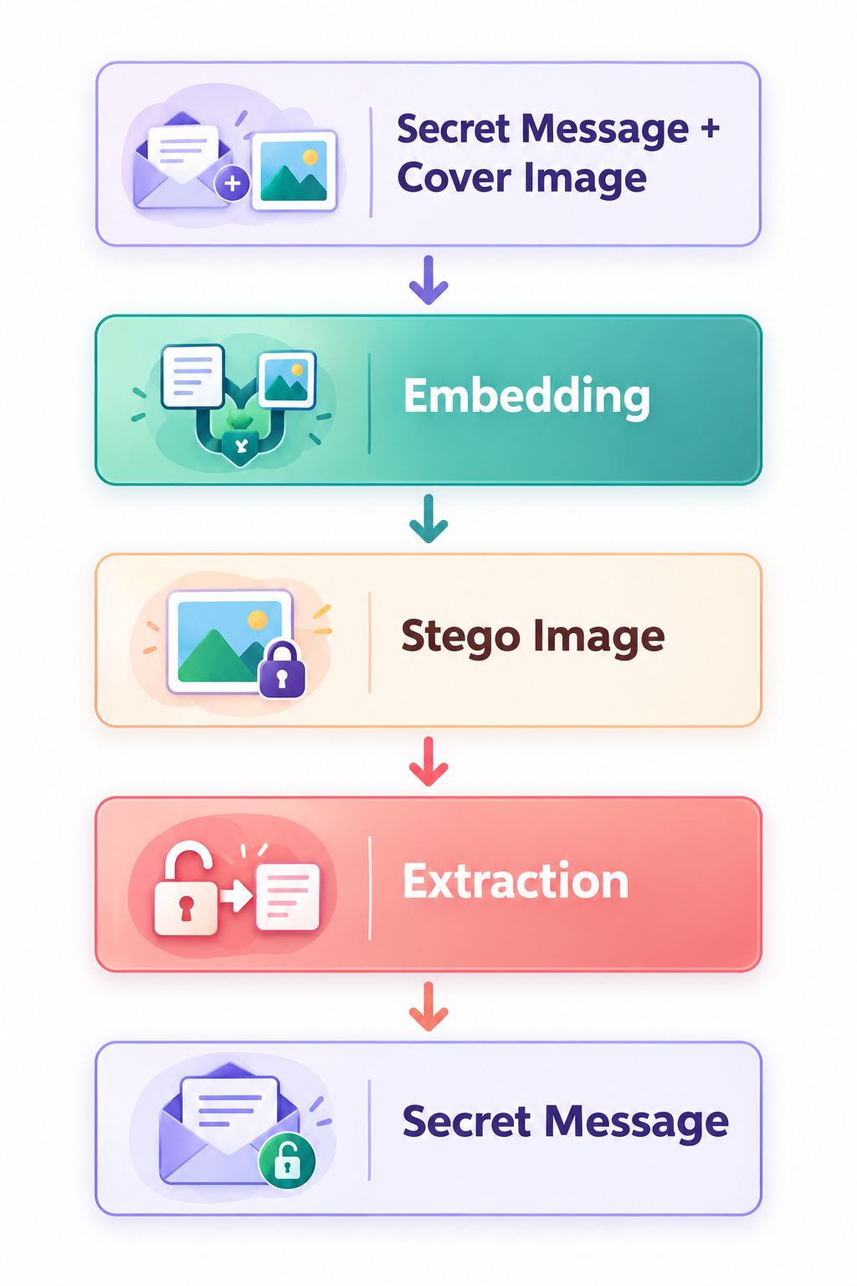
What is Steganography?
Steganography hides secret information inside an ordinary-looking carrier.
Common carriers: images, audio, video and text.
The goal is to conceal the existence of the communication.
LSB idea (simplified conceptual example)
Original pixel
1
0
1
1
0
0
1
0
= 178
Secret bit
1
replaces the last bit of the pixel
Modified pixel
1
0
1
1
0
0
1
1
= 179
Only the least significant bit changes (178 → 179), so the colour barely changes.

Slide 5
Cryptography vs Steganography
Feature | Cryptography | Steganography
Main purpose | Protect message content | Hide message existence
Output | Ciphertext | Stego object
Secret visibility | Communication is visible | Communication is concealed
Key | Usually required | Optional depending on method
Capacity | Generally high | Limited by carrier
Detection | Ciphertext is obvious | Requires steganalysis
Example | AES, RSA | LSB image hiding
Key idea
Cryptography hides the meaning.
Steganography hides the existence.

Slide 6
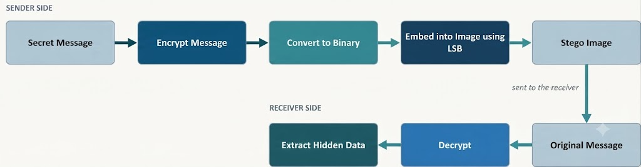
Proposed Practical Demonstration
Illustrative example
Proposed checks
“MEET AT 5 PM”
[Ciphertext]
Stego Image
“MEET AT 5 PM”
Recovered message matches original
Cover vs stego compared visually
Capacity estimated from image size
Original message
After encryption
After embedding
After extraction + decryption

Slide 7
Applications and Security Considerations
Applications
Secure communication
Digital watermarking
Copyright protection
Authentication
Tamper detection
Confidential information exchange
Cryptography
Advantages
Strong confidentiality
Widely used and standardized
Limitations
Ciphertext may attract attention.
Steganography
Advantages
Conceals the presence of communication
Can use ordinary digital media
Limitations
Limited hiding capacity.
Can potentially be detected using steganalysis.

Slide 8
Conclusion
Cryptography protects the content of information.
Steganography hides the existence of information.
They solve different but complementary security problems.
Combining both can provide layered protection.
Encryption
Confidentiality
Steganography
Concealment
Encryption + Steganography
Layered Security
“Cryptography protects the message; steganography protects the secrecy of its presence.”

Slide 9


